Slide 1

RISK AND RESILIENCE BOOTCAMP
4

Slide 2


Slide 3
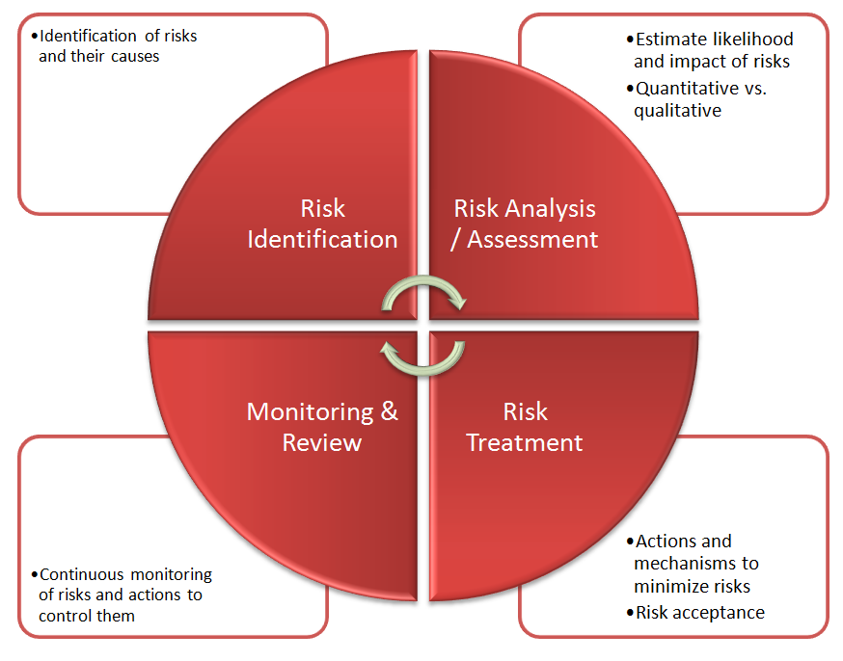
Risk identification
In this module we will cover
Risk identification methods
Exploratory risk analysis

Slide 4
Risk Identification Methods
First actionable stage in the risk management lifecycle
Needs to happen before risk analysis, evaluation and management
Links directly to risk typologies
Operational, strategic, compliance, reputation
Links to risk types
Process, product, business/legal/financial
Objective:
To identify potential events or conditions (threats, vulnerabilities, asset exposures, control gaps) that could impact business objectives or system resilience (e.g., mission-critical services, IT assets, operational processes)
Not a one-time activity, but should be iterative and ongoing responsive to changes in environment, technology, regulation, process, business model

Slide 5
Risk Identification Methods
Emergent risk identification
New risks may surface as systems evolve, both internal and external
New risks my emerge from market and social innovations, crises and changes
Including black swan events
Should be comprehensive
Multiple viewpoints: operations, IT, vendors, third-parties, end-users
Essential for effective risk statements, risk registers, and subsequent risk analysis and testing

Slide 6
interviews
Preparation
Purpose: Ensure the interview is structured, goal-oriented, and aligned with the organization’s risk framework
A well-planned interview minimizes wasted time and increases the reliability of findings
Key activities
Define the scope
What part of the business or system is being reviewed?
Example: Customer-facing web applications, data centers, supplier onboarding.
What type of risk do you seek to uncover?
Operational, compliance, reputational, process, etc.
Align with risk appetite and tolerance levels already defined in the organization

Slide 7
interviews
Key activities
Identify target roles and stakeholders
Include multiple perspectives:
Process owners: know daily operations and bottlenecks
System administrators or engineers: understand control mechanisms and technical vulnerabilities
Business stakeholders: grasp business objectives, financial exposure, and customer impact
Vendors or third-party partners: identify supply-chain risks
Front-line staff: reveal practical workarounds or shadow systems
Balance hierarchical levels
Senior leaders provide strategic risks; operational staff reveal execution risks

Slide 8
interviews
Key activities
Set objectives and logistics
Clarify the purpose: discovery, validation, or follow-up
Determine interview format: one-on-one, group workshop, or panel
Allocate sufficient time (30–60 minutes typical)
Send participants a short briefing describing the purpose and assuring confidentiality
Best practice tip
Use a Risk Identification Worksheet to log participant names, domain, risk category focus, and notes

Slide 9
interviews
Designing the interview guide
Goal: Create a structured but flexible framework that elicits both factual and interpretive information
Structure
Opening questions: build context
“Describe your role and daily responsibilities”
Exploratory questions: uncover known and latent risks
“What could prevent you from meeting your targets?”
Analytical questions: evaluate existing controls
“How do you monitor for errors or exceptions?”
Reflective questions: uncover behavioral and cultural risks
“Do people feel safe raising problems?”

Slide 10
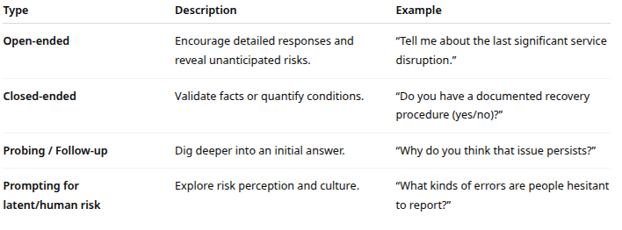
interviews
Question types

Slide 11
interviews
Tailoring by stakeholder role
Process owners: ask about bottlenecks, manual steps, exception handling
Vendors: ask about contract dependencies, SLA adherence, escalation procedures
Business stakeholders: focus on financial, legal, or reputational impact of disruptions
Technical teams: probe system vulnerabilities, logging, monitoring, or change-control practices
Deliverable: A written guide with core questions and a space for notes, ratings (e.g., likelihood/impact), and references to evidences

Slide 12
interviews
Conducting the interview
Purpose: Create a conversation that yields genuine insights rather than scripted answers
Structure
Establishing rapport
Begin with introductions, confidentiality assurance, and explanation of why their input matters
Use neutral, non-judgmental language (“help us understand” instead of “audit” or “investigate”)
Demonstrate active listening: maintain eye contact, summarize answers, and check understanding
Capturing insights
Take structured notes or record (with consent)
Tag responses with relevant risk categories and control references
Pay attention to tone and emotion: hesitation or defensiveness often signals areas of concern

Slide 13
interviews
Structure
Probing for “hidden” risks
Explore shadow IT (unauthorized tools or workarounds)
Identify cultural or behavioral risks: lack of accountability, fear of escalation
Look for process gaps: missing hand-offs, unclear ownership, outdated procedures
Ask scenario-based prompts like
“If this system failed on a weekend, what would you do?”
“How long could you continue operations manually?”
Managing group dynamics
In workshops, prevent dominant voices from overshadowing quieter participants
Encourage cross-functional discussion to reveal dependencies

Slide 14
interviews
Post-interview activities
Purpose: Turn raw interview data into actionable risk insights
Document findings
Summarize responses in a risk identification template
Source → Risk condition → Consequence → Existing controls → Owner → Evidence
Use direct quotes for strong insights (e.g., “We don’t have time to verify every nightly backup.”)
Synthesize into risk statements
Convert observations into standardized form:
If [condition], then [event] may occur, leading to [consequence]
Example: “If vendor onboarding is not independently verified, third-party access may be provisioned incorrectly, leading to data exposure.”

Slide 15
interviews
Document findings
Cross-check with other evidence
Compare interview insights against logs, incident reports, and checklists
Validate inconsistencies: does operational data support what people said
Flag contradictions for follow-up investigation.
Communicate findings
Present results to risk owners or governance committees
Prioritize issues for inclusion in the risk register

Slide 16
Log and Data Review
Logs
Digital footprints of activities, events, and control actions across systems and processes
Represent how the organization’s technology, people, and controls actually behave, not how they are documented to behave
Goal is to move from raw data to meaningful patterns that may indicate risk conditions or control failures
Anomalies
Unusual patterns in access, usage, or transaction data
Example: Spike in failed logins outside business hours → potential brute-force attack or misconfiguration
Example: System restarts at irregular intervals → stability issue or unauthorized reboot

Slide 17
Log and Data Review
Recurring events
Same error or alert type repeating across systems or time periods
Example: Monthly backup job failing → risk of data loss
Example: Repeated password reset requests → possible credential fatigue or phishing
Trend patterns
Gradual increase or decrease in certain events or metrics
Example: Increasing incident resolution times suggesting staffing or skill shortage risk
Example: Decreasing ticket closure rate suggesting operational inefficiency
Deviations from expected behavior
“Normal” baseline drift: performance metrics or logs diverge from their usual range
Example: Transaction volume drop without business reason suggest potential outage, process failure, or fraud
Example: Firewall rule count rising unexpectedly suggests configuration drift or security overcomplication

Slide 18
Log and Data Review
Threshold deviations
SLA or KPI breaches
Example: Incident resolution time rises above SLA limit
Compliance gaps
Missing log entries or unreviewed exceptions suggest an audit deficiency
Advanced patterns
Correlated anomalies: e.g., spike in system errors + delayed customer support responses suggests combined process risk
Silent periods
Absence of logs where activity is expected (indicator of failure or tampering)

Slide 19
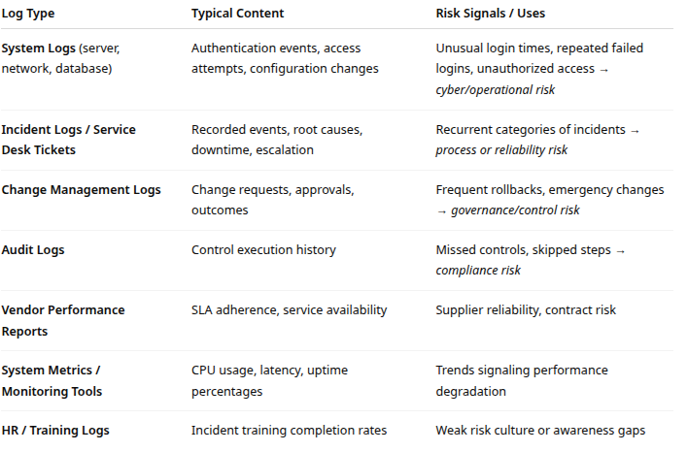
Types of Logs and Data Sources

Slide 20
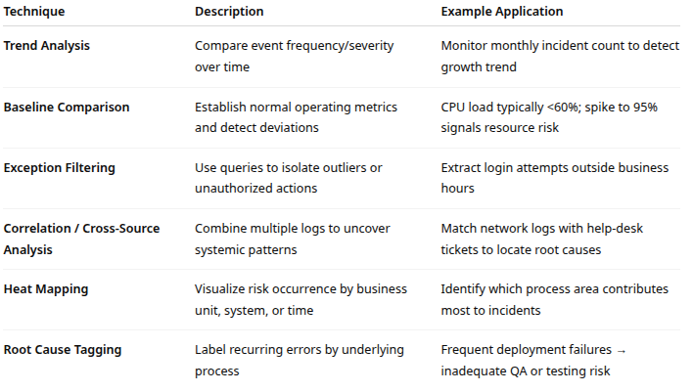
Techniques for Analysis

Slide 21
Log and Data Review
Deliverables and outputs
List of risk conditions identified
Example entries:
Increase in failed logins suggest possible credential abuse risk
Frequent unplanned system changes suggest inadequate change governance
Incident tickets recurring for same issue suggest ineffective corrective control
Preliminary risk statements
Condition → Event → Consequence format:
“If configuration changes are not reviewed (condition), systems may be deployed insecurely (event), resulting in data exposure (consequence)”
Summary dashboard or table
Columns: Data Source | Observation | Risk Category | Suggested Owner | Supporting Evidence
Cross-reference map
Align identified risks to controls, vulnerabilities, and assets: key ISACA practice for traceability

Slide 22
Checklists
Checklists
Structured, repeatable tools used to identify known or foreseeable risks
Provide discipline, consistency, and traceability to the risk discovery process
Ensure that essential categories, controls, and scenarios are not overlooked
Can be aligned with industry frameworks
ISACA, ISO 31000, NIST, DRI
Allow analysts to connect organizational practices to globally recognized standards
Provide a systematic method for scanning known risk areas and verifying that expected controls and practices exist
Complements the qualitative and data-driven methods (interviews, logs) by enforcing coverage and repeatability

Slide 23
Checklists
Value to analysts
Prevents risk “blind spots” by ensuring that all domains, systems, and process categories are reviewed
Translates abstract risk concepts into operationally testable questions
Supports audits, regulatory reviews, and resilience maturity assessments
Relevance to risk typologies:
Operational risks: verify procedures, escalation, continuity
Compliance risks: ensure mandatory policies, records, or training exist
Process and product risks: confirm quality control, testing, and approval mechanisms
Business/legal risks: ensure contracts, third-party agreements, or insurance coverage align with appetite

Slide 24
Checklists
Framework sources for checklist design
Purpose: Anchor checklist questions in recognized governance frameworks and resilience standards
Building an effective risk checklist
Key components:
Risk domain headers: Operational, Financial, Strategic, Compliance, IT, HR, Vendor.
Question / test statement: “Are vendor performance reviews conducted at least quarterly?”
Expected evidence: Policy, report, log, or statement verifying existence
Status or rating field: “Yes / No / Partially Implemented”
Risk level or impact: High/Medium/Low or numeric scoring
Owner / reviewer: Accountability assignment

Slide 25
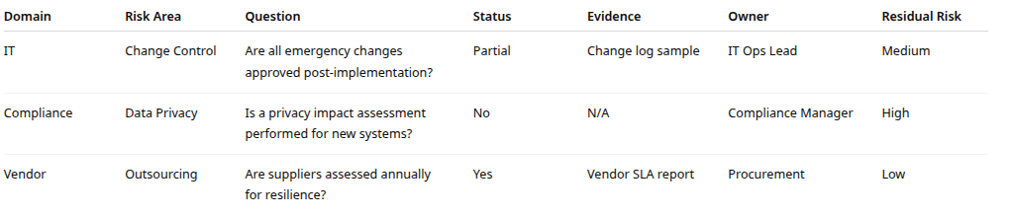
Sample Format (Spreadsheet Example)

Slide 26
Checklists
Execution and scoring
Steps:
Preparation: Define scope (process, system, function)
Apply checklist questions: Through interviews, documentation review, or observation
Record results: Use Yes/No/Partial or maturity scores (1–5 scale)
Summarize gaps: Identify which controls or processes are missing or weak
Rate associated risks: Evaluate likelihood/impact of gaps and update the risk register

Slide 27
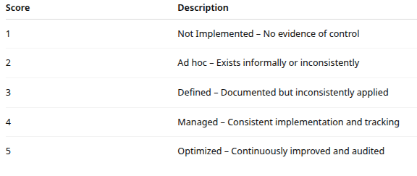
Scoring model example

Slide 28
Advantages and Limitations
Advantages
Efficient, fast, and repeatable
Ideal for structured assessments, internal audits, and onboarding new analysts
Encourages organizational learning and forms a knowledge base for recurring assessments
Helps verify compliance and readiness for regulatory revie Evaluate likelihood/impact of gaps and update the risk register

Slide 29
Advantages and Limitations
Limitations
Focused on known risks: may miss new, emergent, or cultural risks
Over-reliance can promote “check-the-box” behavior
May not uncover systemic interdependencies (which require exploratory methods)
Requires periodic updates to remain relevant

Slide 30
Best practices
Completeness over creativity
Checklists ensure all baseline risk areas are covered, preventing oversight
Framework traceability
Linking questions to standards (COBIT, ISO) enhances audit defensibility
Periodic review
Checklist questions should evolve with changes in risk appetite, business models, or regulation
Balance of depth vs breadth
Avoid excessively granular checklists that reduce focus; prioritize critical controls.
Data validation
Combine checklist results with logs and interviews for a 360° view.

Slide 31
Best practices
Completeness over creativity
Checklists ensure all baseline risk areas are covered, preventing oversight
Framework traceability
Linking questions to standards (COBIT, ISO) enhances audit defensibility
Periodic review
Checklist questions should evolve with changes in risk appetite, business models, or regulation
Balance of depth vs breadth
Avoid excessively granular checklists that reduce focus; prioritize critical controls.
Data validation
Combine checklist results with logs and interviews for a 360° view.

Slide 32
Exploratory Risk Analysis
Deep, open-ended investigation beyond checklists and standard models
Moves beyond compliance-driven reviews to learning-oriented inquiry
Encourages hypothesis-driven analysis (“What if this fails?”)
Supports DRI’s Prepare → Respond → Recover → Adapt lifecycle
Enables anticipation of systemic and cascading failures

Slide 33
Techniques
Scenario building and stress testing
Construct “What-if” scenarios around disruptions
For example: data center outage, insider threats
Assess second-order effects
For example: impacts on customers, supply chain, or reputation
Use qualitative scoring or Monte Carlo simulation for likelihood/impact analysis
Example: “What if the primary payment API fails on a Friday at month-end?”

Slide 34
Techniques
Failure mode and effects analysis (FMEA)
Identify each process step’s potential failure modes, causes, and effect
Assign severity, likelihood, and detectability scores (S × L × D)
Prioritize high-risk failure points for mitigation
Bow-Tie analysis
Visual model linking causes → event → consequences with corresponding controls
Helps visualize preventive and corrective control effectiveness

Slide 35
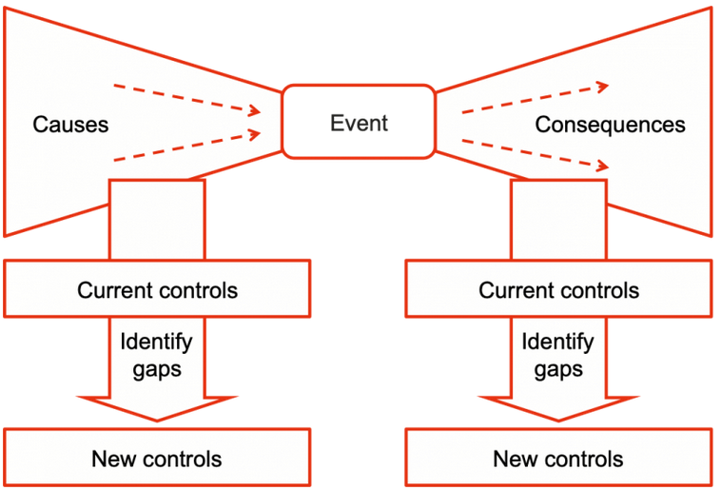
Bow Tie

Slide 36
Techniques
Red team / tabletop exercises
Simulate adversarial or crisis conditions to test detection and response
Focus on cross-functional communication and control execution
Trend and external signal scanning
Monitor emerging risk drivers: geopolitical, regulatory, technological
Use threat intelligence, audit findings, and industry reports to enrich risk awareness

Slide 37
Analysis
Cognitive and behavioral aspects
Avoid cognitive bias in assessment
Availability bias (overweighting recent incidents)
Groupthink (suppression of dissenting views)
Confirmation bias (seeking evidence to support existing beliefs)
Encourage diverse participation (operations, compliance, cyber, HR, vendors)

Slide 38
Integrating exploratory results
Translate findings into
New risk statements or control recommendations
Lessons learned feeding into SOPs, training, and testing cycles
Correlate exploratory insights with risk appetite and tolerance thresholds
High-impact, low-probability events → evaluate residual risk vs. risk capacity
Example:
A ransomware simulation reveals that supplier data access is unmonitored
Results in new risk category: third-party data exposure

Slide 39
Output and Governance
Document outcomes in risk workshop reports, including
Discovered risks, assumptions, unknowns, early warning indicators
Mitigation proposals and ownership
Feed results into risk registers and resilience improvement plans

Slide 40

Q&A and open discussion
Notes:
Now is the time to engage in an interactive Q&A session where you can ask questions, share insights, and clarify any doubts about the topics we have covered so far.
This open discussion is designed to ensure that every participant has the opportunity to voice their thoughts and learn from the collective experience of the group.
Your questions and comments are valuable as they help us identify areas that may need further explanation and enable us to tailor future sessions to your needs.
We encourage you to speak up and contribute to the dialogue, as this interaction is one of the key components of our interactive learning approach.
As the session progresses, take note of any questions or ideas that you would like to revisit, and feel free to share your perspectives with the class.

